Slide 1
POINTERS

Slide 2
A pointer variable is a variable that stores address of other variable
A pointer variable is a variable that contains memory location of another variable.
It represents the location of a data item such as a variable or an array element.
Pointers provide a handy way to access arrays and strings
Pointers are also used for dynamically allocating memory for variables.
Declaring pointer variable-
datatype *pointer_variable;
pointer_variable= &variable;

Slide 3
int *p;
char *pc;
float *fp;
Int x=10,n;
int *p;
*p=*(&n);
clrscr();
Printf(“Enter value of n”);
scanf(“%d”,&n); // 45
Printf(“\nValue of n is %d”,n); // 45
Printf(“\n No entered is %d”,*p); // (*(1212)0)=45
printf(“\n address of n is %u”,&n); // 1212
printf(“\n address of p is %u”,&p);//4532
x=10
Address= 1212
P=&x=1212
Address 6875
n=45
Address 1212
P=&n=1212
Address 4532

Slide 4
%d
%c
%f
%s
%u- address of variable

Slide 5
int *p;
char *pc;
float *fp;
Int x=10,n;
int *p;
p=&n;
Clrscr();
Printf(“Enter value of n”);
Scanff(“%d”,&n); // 5
Printf(“\nValue of n is %d”,n); // 5
Printf(“\n No entered is %d”,*p); // *(&n)= 5
printf(“\n address of n is %u”,&n); // 9876 *p=*(&n) 5 p printf(“\n address of p is %u”,&p);// 6875
printf(“\n value at p is %d”,p);// 9876
Printf(value at p is %u”,p);// 9876
x=10
Address= 1212
P=&x=1212
Address 6875
n=5
Address 9876
P=&n=9876
Address 6875

Slide 6
int i;
int *j;
j=&i;= 1002
(&i)= 1002
*(&i)= 3 = *(1002)
*(j)= *(&i)=3
&(j)=1004
Address= integer
%d
(%d, j)= 1002
(%u, j); 1002
(%u,&j)= 1004
i=3
Address= 1002
J=1002
Address= 1004

Slide 7
Void main()
{
int a=2,b=6;
int *p;
p=&a;
printf(“\n a=%d”,*p); //*(&a)= value at address of a===2
p=&b;
printf(“\n b=%d”,*p);// *(&b)=6
}
A=2
Address =9090
b=6
Address =7777
P= 7777
Address =1212

Slide 8
Pointer arithmetic
int n=2,m=3,s=0,mul=0,div;
int *p1,*p2; //pointer
p1=&n;
p2=&m;
s=*p1+*p2; (value at address of n + value at address of m)=5
mul=s * (*p1); //mul= 5 * (value at address of n) =10
*p2=*p2+1;
div= 9 + (*p1) / (*p2) -30;
Comparison operator
p1>p2 p1<=p2 p1==p2 p1!=p2
Prefix postfix increment and decrement
Int n1=2, n2=3;
Int *p=&n1;
Int *q=&n2;
(*p)++= *(q)++; //run
mul=s * (*p1);

Slide 9
void main()
{
char *f=“Hello World”;
printf(“%s”,f); // HELLO WORLD
}
‘ ’- character
“ “ - string

Slide 10
int i=3,*j;
j=&i;
printf(“\n address of i=%u ”,&i);
printf(“\n address of i=%u ”,j);
printf(“\n address of j=%u ”,&j);
printf(“\n value at j=%u ”,j);
printf(“\n value at i=%d ”, i);
printf(“\n value of i=%d ”,*(&i));
printf(“\n address of i=%d ”,*j);
j=&i=1002
Address 1004
i=3
Address= 1002

Slide 11
PRACTICE QUESTIONS
Q1. WAP to add two floating point numbers. The result should only be 2 digit after decimal.
Q2. WAP to calculate area of circle using pointers
Q3. WAP to convert floating point number to integer using pointers and type casting
Q4. WAP to find largest of 3 numbers using pointers
Q5. WAP to enter a character and then check whether entered character is vowel or not using pointers.
Q6. WAP to check whether a character entered is in upper case or lower case using pointers.
Q7. WAP to test whether a number is positive, negative or equal to zero using pointers.
Q8. WAP to display the sum and average of numbers from m to n.
Q9. WAP to print all prime numbers from 1 to 50 using pointers.
Q10. WAP to print all even numbers from m to n using pointers.

Slide 12
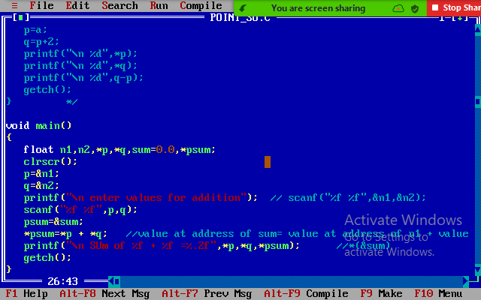
Q1

Slide 13
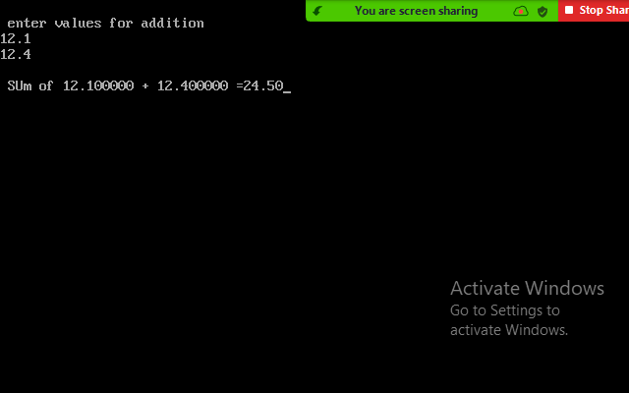
output

Slide 14
Pointer to an array
Like we have pointer to an integer, a pointer to a float, a pointer to a character, we can also have pointer to an array.
void main()
{
int arr[]={1,2,3,4,5};
int *ptr,i;
ptr=&arr[0]; // base address
for(i=0;i<5;i++)
{ printf(“Address are: %u %u %u”,arr,&arr[i],&arr); //1212, 1212, 1212 1214
printf(“\n Values are: %d”, *ptr);// *&arr[0]=1 *&arr[1]=2
ptr++; // incrementing pointer variable= incrementing address by 2(INT)
}
}
1 (1212) | 2(1214) | 3 | 4 | 5
Ptr= &arr[1] 1414

Slide 15
Cont..
From array we know that arr[i] is equivalent to *(arr+i) and arr=arr[0]. Similarly, following is true
ptr=arr; //ptr=&arr[0] BASE ADDRESS
Therefore,
The name of an array is equivalent to address of its first element, as a pointer is equivalent to address of the element that it points to. Hence, arrays & pointers have same concept.
arr=arr[i]=i[arr]=*(arr+i)=*(i+arr) gives same output

Slide 16
Eg void main()
{
int a[]={1,2,3,4,5};
int *p,i;
p=&a[2];
*p=-1;
*(p+1)=0;
*(p-1)=1;
printf(“\n The array is:”);
for(i=0;i<5;i++)
printf(“\n %d”,*(a+i));//
}
1 | 1 | -1 | 0 | 5

Slide 17
Subtraction of two pointer variables- we can subtract or add 2 pointers if they point to the same array.
void main()
{
int x[]={10,20,30,40,50,60,70,80,90};
int *p1,*p2;
p1=x; // p1= &x[0] or p1=x[0]
*p2=*p1 + 2; // 12
printf(“%d”,*p1); // 10
printf(“\n %d”,*p2); // 12
printf(“\n %d”, *p2 - *p1); 2
}

Slide 18
Comparison of two pointer variables
void main()
{
int x[]={10,20,30,40,50,60,70,80,90};
int *p,*q;
p=x; // &x[0] or x[0]
q=&x[8];
while(q>=p)
{ printf(“%d”,*p); // 10, 20, 30………………
p++;
}
}
10 (4545) | 20 | 30 | 40 | 50 | 60 | 70 | 80 | 90
P= &x[1]= 1214
Q= &x[8]=1228

Slide 19
Q. WAP to read and display an array of n integers-
CODE- void main()
{
int I,n,a[10],*p=a; // p=a[0]
printf(“\n Enter the number of array elements”);
scanf(“%d”,&n);
printf(“\n Enter the elements”);
for(i=0;i<5;i++)
scanf(“%d”,(p+i));
printf(“\n the elements entered are”);
for(i=0;i<5;i++)
printf(“%d”,*(p+i));
}

Slide 20
Array of pointers- collection of addresses
As we have array of ints or array of floats we can have array of pointers. Since a pointer variable always contains addresses an array of pointers is a collection of addresses
Datatype *ptr_name[size]; // 1 D
Datatype **ptr_name[rowsize][colsize]; // 2D
The addresses present in the array of pointers can be-
addresses of isolated variables/ random, or [&x, &y,&r] - array of pointers
address of other array variable. [1,2,3,4,5] [4,-6,90, 5]

Slide 21
Addresses of isolated variables/ random
Void main()
{
int *p[10]; // array of pointer//sequemce
int q=1, r=2,s=3,t=4,u=5; // randomly
p[0]=&q;
p[1]=&r;
p[2]=&s;
p[3]=&t;
p[4]=&u;
OR p[]={&q,&r,&s,&t,&u};
printf(“%d”,*p[4]); // *(&u)= 5
=4
P[0] &q=1013 &p[0]= 1000 | P[1]= &r=4007 &p[1]= 1002 | P[2] =&s= 5656 &p[2]= 1004 | P[3]=&t= 7890 &p[3]= 1006 | P[4]=&u= 1234 &p[4]= 1008

Slide 22
Addresses of entire array element
void main()
{
int p[]={1,2,3,4,5};
int q[]={0,1,2,3,4};
int r[]={7,8,9,10,11};
int *t[3]={p,q,r}; //OR {&p[0], &q[0], &r[0]}
int i;
for(i=0;i<3;i++) //i=0,1,2
printf(“\n %d”,*t[i]); // 1, 0,7
}
T[0]=p= &p[0]= 1234 | T[1]=q=&q[0]=4567 | T[2]=r=&r[0]= 9999

Slide 23
Pointer to function/ passing arguments to function using pointers/call by reference
This concept is similar to call by reference in which the calling function passes address to the function call for reference. Thus, passing pointers to function avoids the overhead of copying data from one function to another. Hence, to use pointers for passing arguments to a function, following must be remembered-
Declare the function arguments/ parameters as pointer
Use of dereferenced pointers in the function body
Pass the address as the actual arguments when the function is called.

Slide 24
Cont….
void main()
{
swap(&h,&g); //actual arguments- calling
}
void swap(int *t, int *y)// formal parameters
{ printf(“”, *t,*y)
}

Slide 25
Array of function pointers/ Array of pointers to the function
datatype (*ptr_arr_name[size]) (parameter list of function);
GLOBAL DECLARATION
Declare/ define- global
SWAP(A,B)

Slide 26
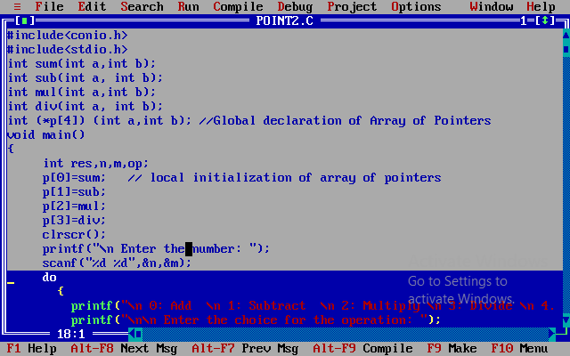

Slide 27
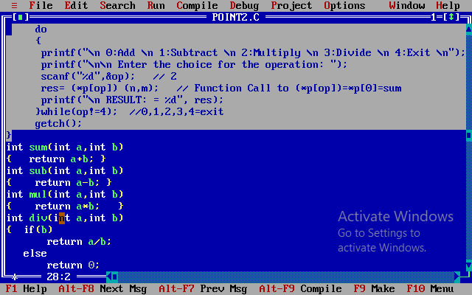

Slide 28
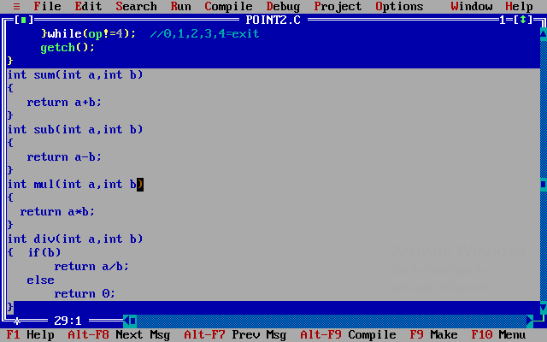

Slide 29
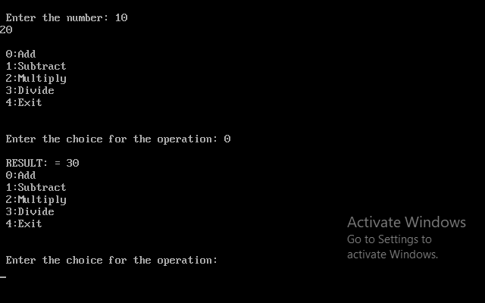
OUTPUT

Slide 30
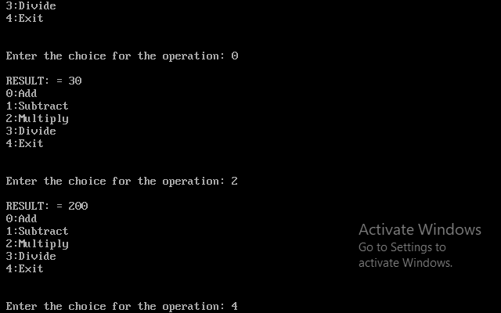

Slide 31
Pointer to pointer (**)
In C we can also use pointer to pointers, i.e one pointer points to another pointer.
To declare pointers to pointers just add another (*) for each level of reference.
Eg. int x=10;
int *p, **q;
p=&x;
q=&p;
printf(“%d”,x);
printf(“%d”,*p);
printf(“%d”,**q);
**q= *(*(&p)) =*(&x)= *(1002)= 10
X=10
Address= 1002
P=&x=1002
Address=2004
Q=&p= 2004
Address = 4008
All statements print output as 10

Slide 32
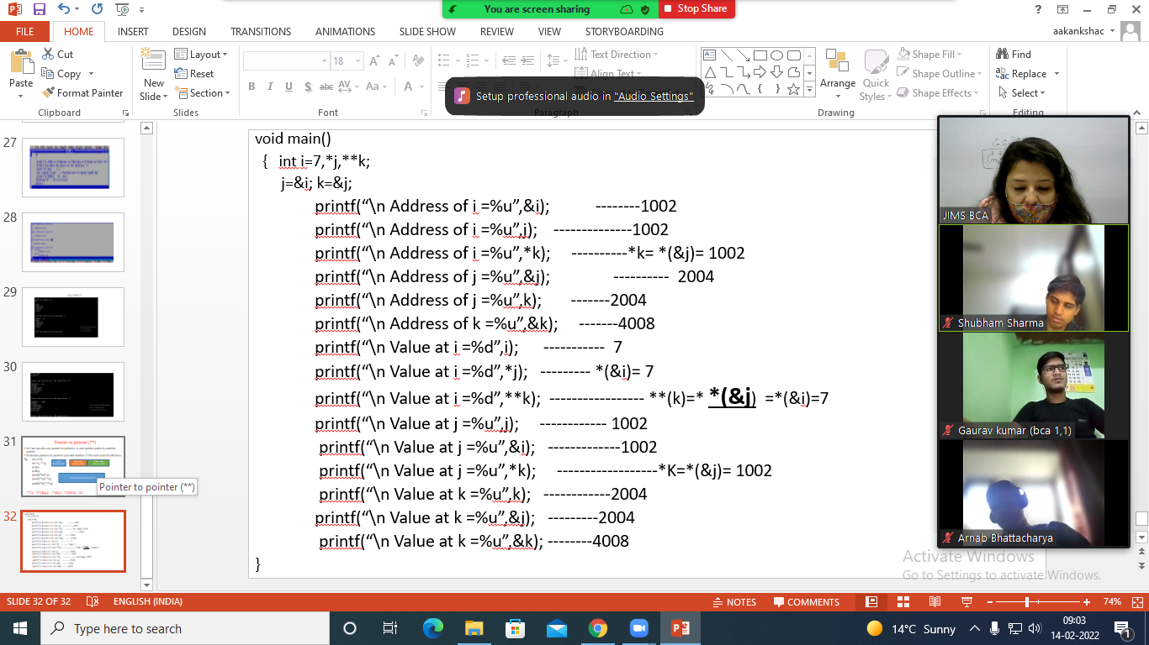
i=7
Address= 1002
J=
Address= 2004
K=
Address= 4008

Slide 33
void main()
{ int i=7,*j,**k;
j=&i; k=&j;
printf(“\n Address of i =%u”,&i); --------1002
printf(“\n Address of i =%u”,j); --------------1002
printf(“\n Address of i =%u”,*k); ----------*k= *(&j)= 1002
printf(“\n Address of j =%u”,&j); ---------- 2004
printf(“\n Address of j =%u”,k); -------2004
printf(“\n Address of k =%u”,&k); -------4008
printf(“\n Value at i =%d”,i); ----------- 7
printf(“\n Value at i =%d”,*j); --------- *(&i)= 7
printf(“\n Value at i =%d”,**k); ----------------- **(k)=* *(&j) =*(&i)=7
printf(“\n Value at j =%u”,j); ------------ 1002
printf(“\n Value at j =%u”,&i); -------------1002
printf(“\n Value at j =%u”,*k); ------------------*K=*(&j)= 1002
printf(“\n Value at k =%u”,k); ------------2004
printf(“\n Value at k =%u”,&j); ---------2004
printf(“\n Value at k =%u”,&k); --------4008
}

